Slide 1

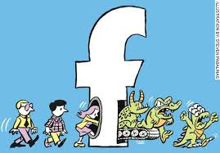
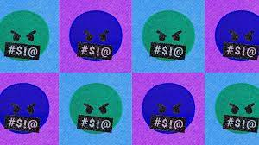
TOXIC COMMENTS CLASSIFICATION for social media FLASK APP
TEAM DEEP BLUE AI MAHE DUBAI
MEMBERS
GIRISH KUMAR MARPALLY
MOHAMED AFSAL MOHAMED
KAUSHIK KRISHNA MOHAN
MOHAMMED ABDUL QUADIR

Slide 2

Toxicity??
the quality of being very harmful or unpleasant in a pervasive or insidious way.
Cyberbullying is a major societal problem that can lead to teen suicides
Toxic comment classifier helps to filter out toxic words to make online world a safer and more harmonious place

Slide 3
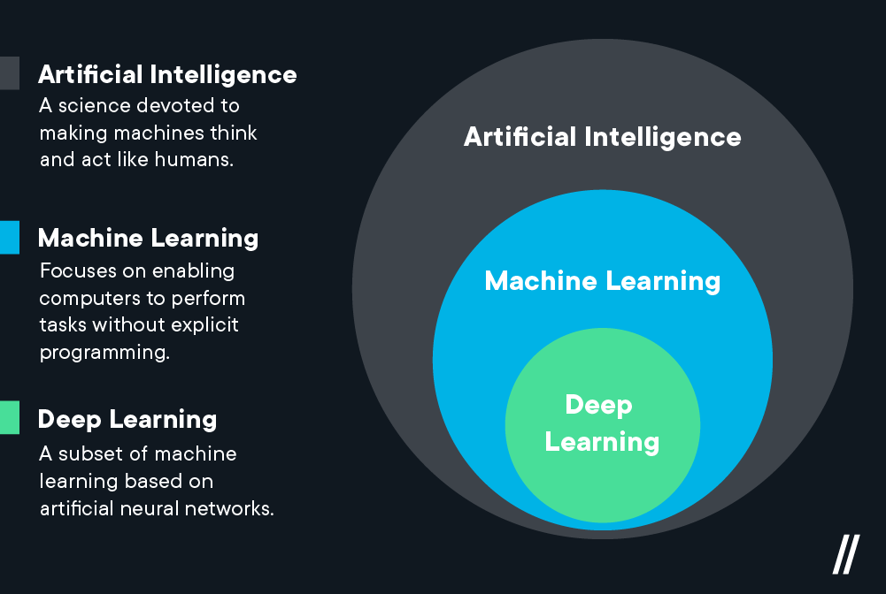
Natural Language Processing (NLP) uses algorithms to understand and manipulate human language. This technology is one of the most broadly applied areas of machine learning. As AI continues to expand, so will the demand for professionals skilled at building models that analyse speech and language, uncover contextual patterns, and produce insights from text and audio.

Slide 4
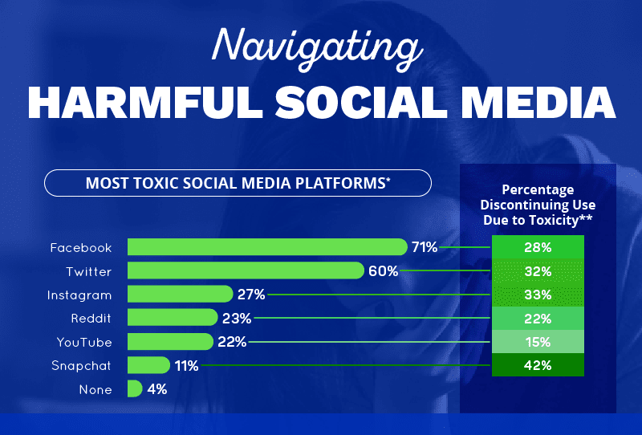

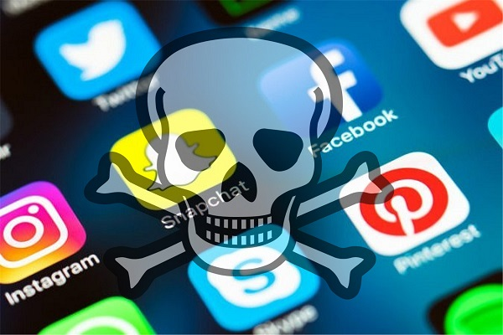
APPLICATIONS
Social media is toxic because it is addictive by design. Also, it is often called toxic because platforms spread disinformation and they encourage their users to engage with these fake news more than with fact checked 'real' news.

Slide 5

The toxic comments classification app could verify if the comments are toxic or not.
In social media users find many toxic comments and that disturbs their experience on social media, and eventually many even end up discontinuing social media altogether.
Social media need not be a bad thing as it has done many good things and has wide range of applications that benefit the world, connecting people.
The comments that are reported by the user as hate, insult, toxic, etc could be verified by the algorithm and take necessary action to remove such comments from social media to make it a friendly and constructive environment.

Slide 6
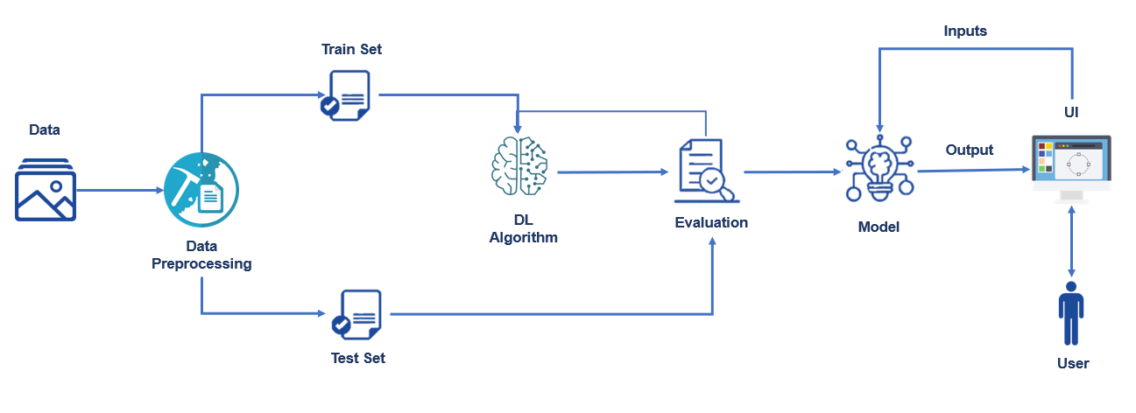
Functioning of the toxic comments classification app

Slide 7
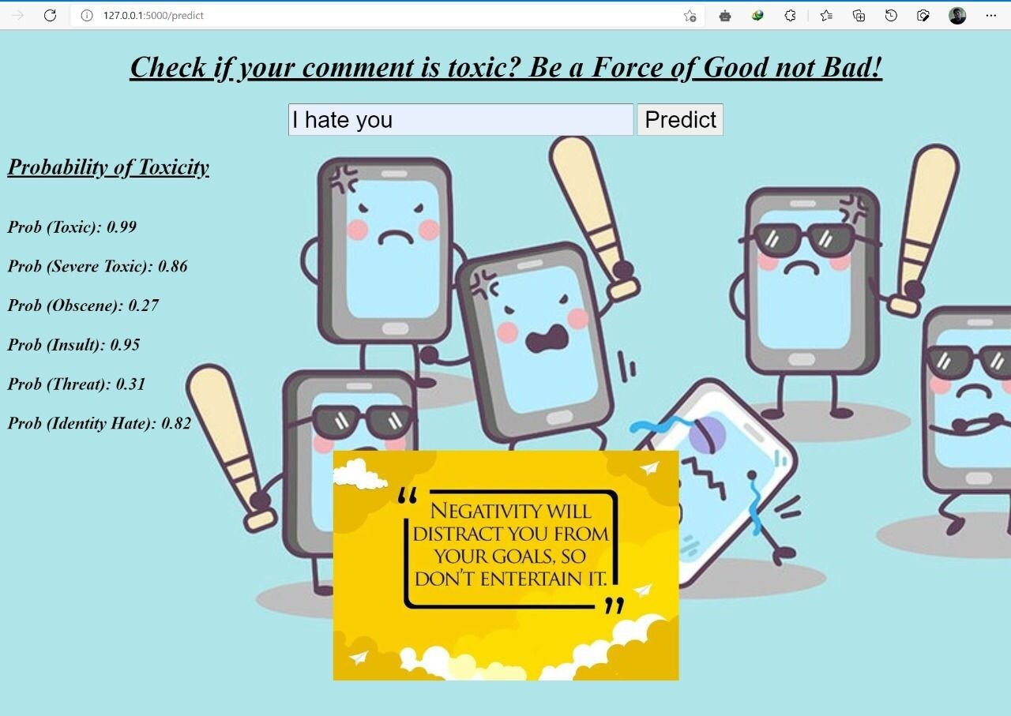
Steps taken to build the app
1.Download the dataset.
2.Pre-process the textual data.
3.Classify the dataset into train and test sets.
4.Add the neural network layers.
5.Load the trained data and fit the model.
Test the model.
6.Save the model and its dependencies.
7.Build a Web application using flask that integrates with the model
built.

Slide 8


Flask app that outputs probability that a comment falls under various categories of toxicity
SCREENSHOTS

Slide 9

-THANK YOU-

